Slide 1
Advanced Terminology in HL7® FHIR®
Rob Hausam MD

Slide 2
This presentation
Can be downloaded here:
https://github.com/FHIR/documents/blob/master/presentations/2023-05-Tutorials/FHIR-Terminology-Advanced/FHIR-Terminology-Advanced-2023-05-11.pptx
Is licensed for use under the Creative Commons, specifically:
Creative Commons Attribution 3.0 Unported License
(Do with it as you wish – just give credit)
Acknowledgements: Grahame Grieve, Lloyd McKenzie
2

Slide 3
This presentation
Based (primarily) on the current official version of HL7 FHIR
FHIR Release 4B (v4.3.0)
https://hl7.org/fhir/R4B/
Some particular relevant and significant differences in the current FHIR R5 (v5.0.0) release (https://hl7.org/fhir/) will be noted
Many (or most) terminology services are anticipated to remain on R4/R4B for an indefinite period of time
3

Slide 4
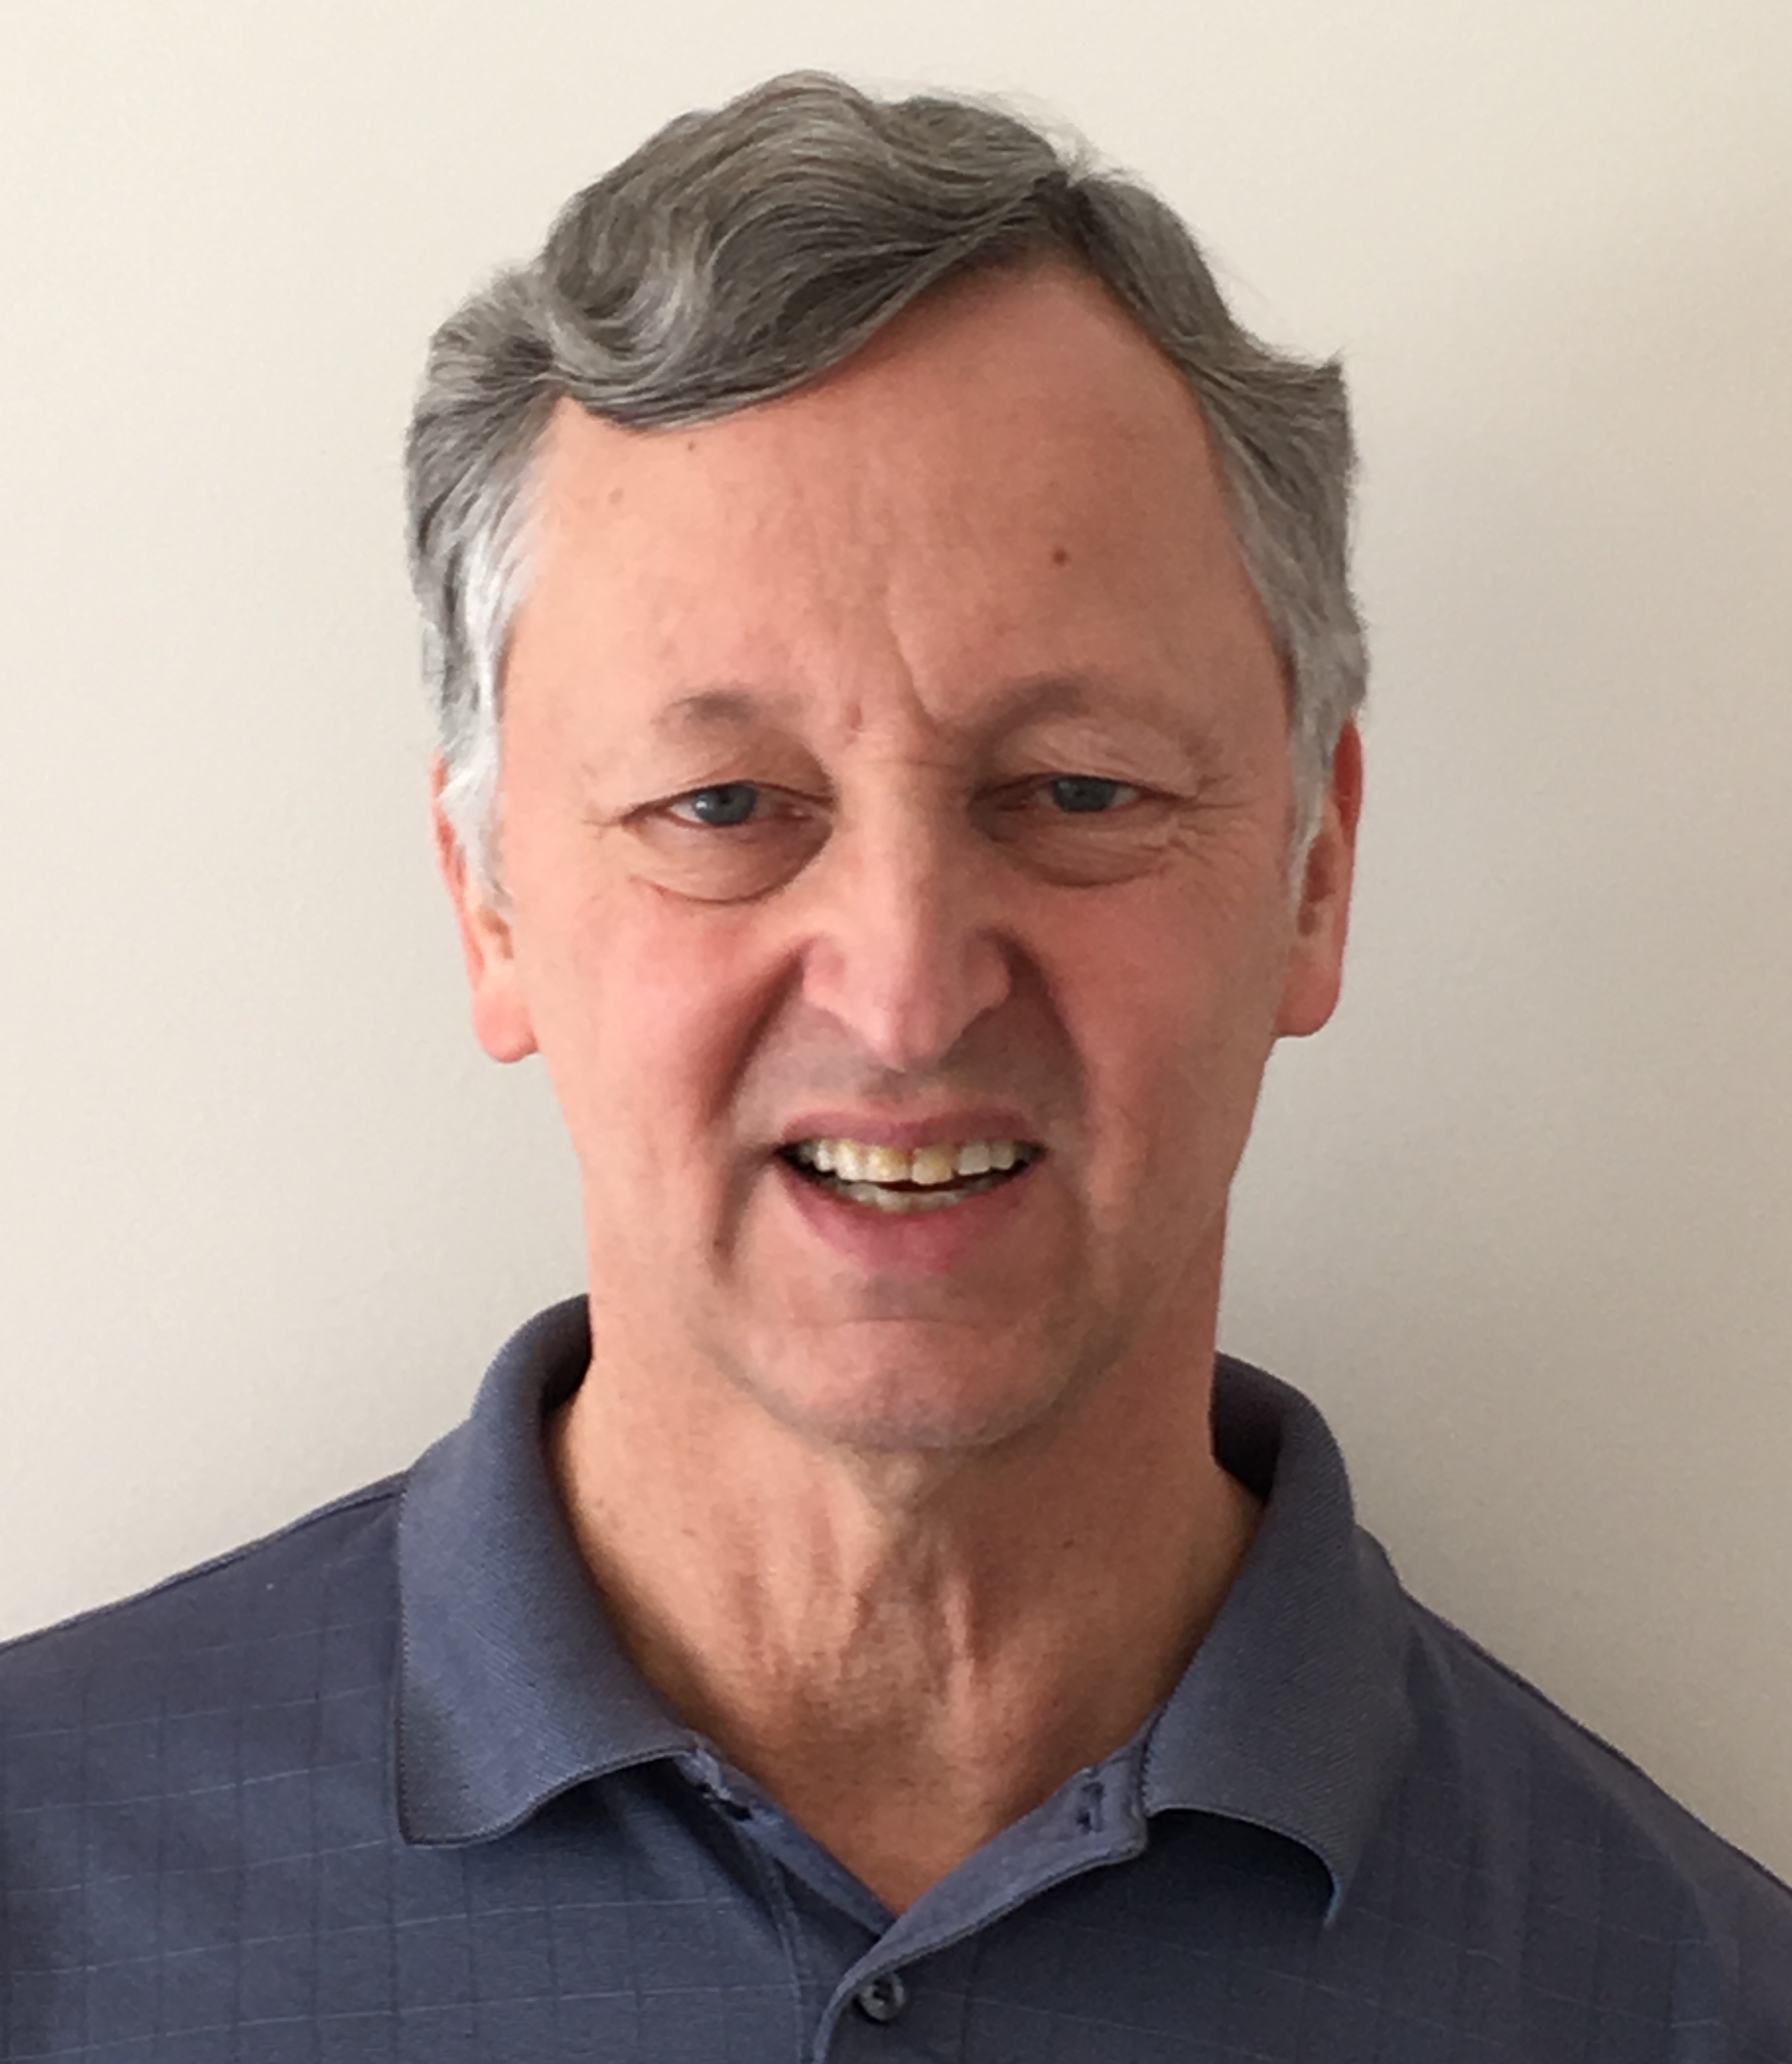
Who am I?
Name: Rob Hausam MD
Company: Hausam Consulting LLC
Background:
Co-chair of Terminology Infrastructure (TI) (formerly Vocabulary) and Orders and Observations (OO) WGs
FHIR specification and Terminology Module editor
Actively involved in HL7 and terminology standards/development and modeling for 22+ years
SNOMED on FHIR project co-lead (joint project of HL7 and SNOMED International)

Slide 5
Tutorial Agenda
Brief Review – Finding terminology in FHIR
Exploration of primary FHIR terminology service operations
$expand, $validate-code, $lookup, $subsumes, $translate
Using SNOMED CT Expression Constraint Language (ECL) in value set definitions
Using FHIR implicit value sets (SNOMED CT and other) with terminology service operations

Slide 6
Tutorial Agenda (cont)
Some terminology-based searching techniques
Features and uses of code system supplements and fragments
FHIR R5 ConceptMap updates If sufficient time and interest:
Questions on Unified Terminology Governance (UTG) process and terminology.hl7.org (THO)
Your additional terminology topics?

Slide 7
Brief review – finding terminology in fhir

Slide 8
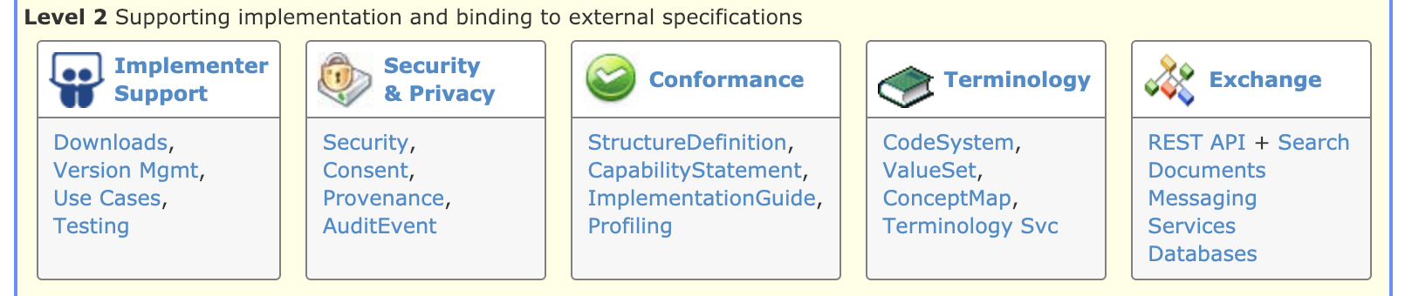
Terminology Module
Level 2 on the Home page
The primary organizing place in the FHIR specification for terminology specifications, guidance and content
http://hl7.org/fhir/terminology-module.html

Slide 9

Terminologies link
Terminologies link
The last link on the right in the top-level (red) navigation bar
The quick and easy way to get to the terminology content in the FHIR specification – code systems, value sets, concept maps

Slide 10
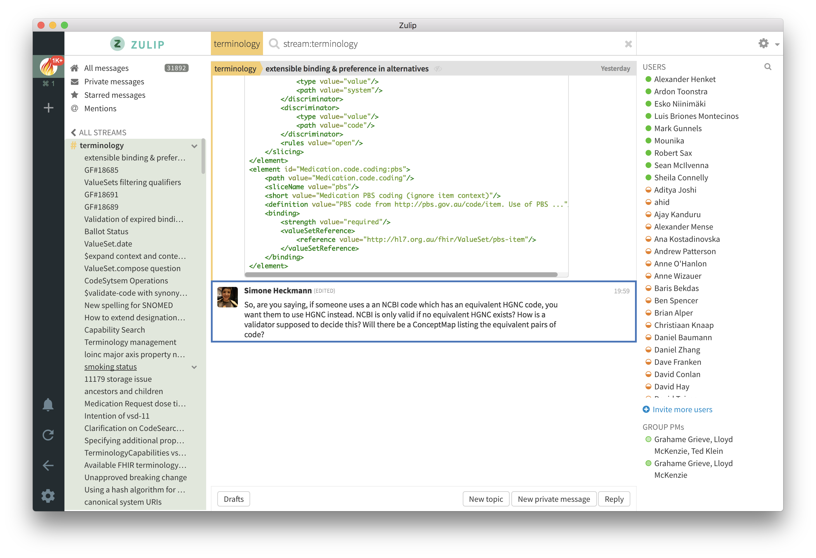
FHIR Zulip chat Terminology stream
https://chat.fhir.org/#narrow/stream/terminology

Slide 11
Exploration of primary FHIR terminology service operations

Slide 12
FHIR Terminology Service Usage Scenarios
Usage scenario | FHIR Terminology Service solution
Obtain a list of codes to populate user interface widget - e.g., a dropdown list. | Invoke the $expand operation with the value set (which contains the codes) as the input parameter
Obtain a list of codes based on what the user has typed in a user interface text box | Invoke the $expand operation with the value set (which contains the codes) and the text the user has entered as the value set and filter input parameters
Determine if a received code is valid. | Invoke the $validate-code operation with the received code as the input parameter
How do I obtain the display names (descriptions) for a code so that I can display it ? | Invoke the $lookup operation with the received code as the input parameter
Obtain a translation of a concept in one code system to a concept in another code system. | Invoke the $translate operation with the source code and a concept map as input parameters

Slide 13
$expand
Takes a ValueSet reference or resource and returns another ValueSet resource containing the expansion (code set)
Default is the current expansion (as of “now”)
Uses include populating a drop-down list, “type ahead” search, etc.

Slide 14
$expand examples
Extensional value set definition (enumerated list)
https://fhir.hausamconsulting.com/r4/ValueSet/procedure-category
https://fhir.hausamconsulting.com/r4/ValueSet/procedure-category/$expand

Slide 15
$expand examples (cont.)
Intensional value set definition (code system query based)
“All codes”
https://fhir.hausamconsulting.com/r4/ValueSet/observation-category
https://fhir.hausamconsulting.com/r4/ValueSet/observation-category/$expand
“is-a” hierarchy
https://fhir.hausamconsulting.com/r4/ValueSet/route-codes
284009009 = “Route of administration value”
https://fhir.hausamconsulting.com/r4/ValueSet/route-codes/$expand

Slide 16
$expand examples (cont.)
Paging (count and offset parameters)
https://fhir.hausamconsulting.com/r4/ValueSet/route-codes/$expand?count=10&offset=0
https://fhir.hausamconsulting.com/r4/ValueSet/route-codes/$expand?count=10&offset=10

Slide 17
$expand examples (cont.)
$expand + filter For type-ahead search (with large value sets)
https://fhir.hausamconsulting.com/r4/ValueSet/route-codes/$expand?filter=intra
https://fhir.hausamconsulting.com/r4/ValueSet/route-codes/$expand?filter=intrales

Slide 18
$expand - new R5 ‘property’ feature
The additional parameter property can be supplied to $expand to request that the values for specified properties are also returned in the expansion (if they exist)
For FHIR R4, Because there is no ‘property’ element defined in ValueSet.expansion.contains, the Extension element http://hl7.org/fhir/5.0/StructureDefinition/extension-ValueSet.expansion.contains.property is used
Example (from CSIRO Ontoserver)

Slide 19
$validate-code
Takes a code/Coding/CodeableConcept and checks if it’s valid against a value set or a code system
Specify value set (same as for $expand)
Code to validate – either code+system (with or without version, display), Coding or CodeableConcept
date – date to validate as of
Outputs: true/false
message if not valid, display names if valid
The primary method for validating coded data

Slide 20
$validate-code example (ValueSet)
FHIR condition-category “problem-list-item”
https://fhir.hausamconsulting.com/r4/ValueSet?url=http://hl7.org/fhir/ValueSet/condition-category
https://fhir.hausamconsulting.com/r4/ValueSet/condition-category
https://fhir.hausamconsulting.com/r4/ValueSet/$expand?url=http://hl7.org/fhir/ValueSet/condition-category
https://fhir.hausamconsulting.com/r4/ValueSet/$validate-code?url=http://hl7.org/fhir/ValueSet/condition-category&system=http://terminology.hl7.org/CodeSystem/condition-category&code=problem-list-item

Slide 21
$validate-code example (CodeSystem)
SNOMED CT “Pneumonia” (233604007)
https://terminz.azurewebsites.net/fhir/CodeSystem/$validate-code?system=http://snomed.info/sct&code=233604007&_format=json&_pretty=true

Slide 22
$lookup
Takes a code+system(version) or Coding and returns additional details about the concept
Name, version, preferred display string, properties (including subproperties) and designations (additional representations for the concept)
Can also be used to determine whether a code exists in the CodeSystem
But returns an OperationOutcome (error) if the code does not exist

Slide 23
$lookup example
SNOMED CT “Pneumonia” (233604007)
Note: Different servers will display different details
https://fhir.hausamconsulting.com/r4/CodeSystem/$lookup?system=http://snomed.info/sct&code=233604007
http://tx.fhir.org/r4/CodeSystem/$lookup?system=http://snomed.info/sct&code=233604007
https://terminz.azurewebsites.net/fhir/CodeSystem/$lookup?system=http://snomed.info/sct&code=233604007&_format=json&_pretty=true

Slide 24
$subsumes
Test whether codeA / codingA subsumes (or is subsumed by) codeB / codingB
Based on the semantics of subsumption in the underlying code system (e.g. SNOMED CT)
Returns one of four possible codes:
equivalent, subsumes, subsumed-by, and not-subsumed
If unable to determine the relationship between codes, returns an error

Slide 25
$subsumes example
SNOMED CT “Viral hepatitis” (3738000), “Disorder of liver” (235856003)
https://fhir.hausamconsulting.com/r4/CodeSystem/$subsumes?system=http://snomed.info/sct&codeA=3738000&codeB=235856003
https://fhir.hausamconsulting.com/r4/CodeSystem/$subsumes?system=http://snomed.info/sct&codeA=235856003&codeB=3738000
“Malarial hepatitis” (83072009), “Viral hepatitis” (3738000)
https://fhir.hausamconsulting.com/r4/CodeSystem/$subsumes?system=http://snomed.info/sct&codeA=83072009&codeB=3738000

Slide 26
$subsumes example (cont.)
SNOMED CT “Viral hepatitis” (3738000), “Viral hepatitis” (3738000)
https://fhir.hausamconsulting.com/r4/CodeSystem/$subsumes?system=http://snomed.info/sct&codeA=3738000&codeB=3738000
https://terminz.azurewebsites.net/fhir/CodeSystem/$subsumes?system=http://snomed.info/sct&codeA=3738000&codeB=3738000 &_format=json&_pretty=true

Slide 27
$subsumes example (cont.)
SNOMED CT “Viral hepatitis” (3738000), “Viral hepatitis” (3738000)
http://tx.fhir.org/r4/CodeSystem/$subsumes?system=http://snomed.info/sct&codeA=3738000&codeB=3738000
https:///r4.ontoserver.csiro.au/fhir/CodeSystem/$subsumes?system=http://snomed.info/sct&codeA=3738000&codeB=3738000
https://snowstorm.ihtsdotools.org/fhir/CodeSystem/$subsumes?system=http://snomed.info/sct&codeA=3738000&codeB=3738000&_format=json&_pretty=true

Slide 28
$translate
Can you translate this code to another code system?
Uses ConceptMap to translate the code(s)
http://...ConceptMap/id$translate
code, Coding or CodeableConcept passed (as per $validate-code)
Output:
True if can be translated
Message if can’t be translated
Translated coding if it can be translated

Slide 29
$translate example
ConceptMap $translate tutorial example: FHIR address-use to V3 AddressUse value sets (Terminz)
ConceptMap resource used in the example: https://terminz.azurewebsites.net/fhir/ConceptMap?source=http://hl7.org/fhir/ValueSet/address-use&target=http://terminology.hl7.org/ValueSet/v3-AddressUse&_format=json&_pretty=true

Slide 30
$translate example (cont.)
ConceptMap $translate tutorial example: FHIR address-use to V3 AddressUse value sets (Terminz)
https://terminz.azurewebsites.net/fhir/ConceptMap/$translate?system=http://hl7.org/fhir/address-use&code=home&source=http://hl7.org/fhir/ValueSet/address-use&target=http://terminology.hl7.org/ValueSet/v3-AddressUse&_format=json&_pretty=true

Slide 31
$translate example (cont.)
ConceptMap $translate tutorial example: FHIR address-use to V3 AddressUse value sets (Terminz)
https://terminz.azurewebsites.net/fhir/ConceptMap/$translate?system=http://hl7.org/fhir/address-use&code=old&source=http://hl7.org/fhir/ValueSet/address-use&target=http://terminology.hl7.org/ValueSet/v3-AddressUse&_format=json&_pretty=true

Slide 32
Using SNOMED CT Expression Constraint Language (ECL) in value set definitions

Slide 33
SNOMED CT Expression Constraint Language (ECL)
A SNOMED CT Expression Constraint is a computable rule that can be used to define a bounded set of clinical meanings represented by either precoordinated or postcoordinated expressions.
SNOMED CT ECL documentation
Not all FHIR servers support ECL!
Ontoserver, Snowstorm and Terminz servers do support ECL

Slide 34
SNOMED CT Expression Constraint Language (ECL) (cont.)
Expressions
http://hl7.org/fhir/snomedct.html#4.3.1.0.5
ECL
See SNOMED CT Filters
See SNOMED CT Implicit Value Sets (fifth bullet in second set)
(This page was moved from the FHIR specification to THO as of R5)
SNOMED CT Browser
Expression Constraint Queries tab

Slide 35
SNOMED CT Expression Constraint Language (ECL) (cont.)
SNOMED ECL Builder (OntoServer)
https://ontoserver.csiro.au/shrimp/ecl/
CSIRO Value Set Comparison Tool
Includes several ECL queries and shows responses (or lack of response) from multiple FHIR servers
http://ontoserver.csiro.au/vstool

Slide 36

ECL Value Set Definition Example
https://build.fhir.org/ig/HL7/fhir-ips/ValueSet-procedures-snomed-ct-ips-free-set.html
POST the ValueSet resource to a server endpoint and invoke the $expand operation (show in VS Code and Postman)

Slide 37
Using FHIR implicit value sets

Slide 38
Implicit Value Sets
Implicit value sets are those whose specification can be predicted based on the grammar of the underlying code system, and the known structure of the URL that identifies them
New documentation on this in ValueSet resource in R5 ballot
Note: There is current ongoing discussion in the Terminology Infrastructure (TI) WG about further revising this description/documentation to make it (hopefully!) more clear – feedback to the TI WG is welcome and encouraged!

Slide 39
Implicit Value Sets
Implicit value sets do not use complex queries
Allows a single URL to serve as a value set definition (without requiring an explicit ValueSet resource)
Can serve as the basis for the $expansion operation
Example - SNOMED CT has common sets of implicit value sets defined (more than any other code system at present):
By Subsumption, By Reference Set, etc.
See https://terminology.hl7.org/SNOMEDCT.html#snomed-ct-implicit-value-sets

Slide 40
Implicit Value Set $expand (isa)
SNOMED CT subtypes of “Pneumonia” (233604007)
https://r4.ontoserver.csiro.au/fhir/ValueSet/$expand?url=http%3A%2F%2Fsnomed.info%2Fsct%3Ffhir_vs=isa%2F233604007&_format=json&_pretty=true
http://tx.fhir.org/r4/ValueSet/$expand?url=http%3A%2F%2Fsnomed.info%2Fsct%3Ffhir_vs=isa%2F233604007
https://terminz.azurewebsites.net/fhir/ValueSet/$expand?url=http%3A%2F%2Fsnomed.info%2Fsct%3Ffhir_vs=isa%2F233604007&_format=json&_pretty=true

Slide 41
Implicit Value Set $expand (ECL expression)
SNOMED CT subtypes of “Pneumonia” (233604007) ECL expression: < 233604007 |Pneumonia (disorder)|
https://r4.ontoserver.csiro.au/fhir/ValueSet/$expand?url=http%3A%2F%2Fsnomed.info%2Fsct%2F900000000000207008%2Fversion%2F20220731%3Ffhir_vs%3Decl%2F%3C%20233604007%20%7CPneumonia%20%28disorder%29%7C&_format=json&_pretty=true

Slide 42
Some Terminology-based searching techniques

Slide 43
Search parameters
Value Set-based Modifiers
ValueSet used in example
https://fhir.hausamconsulting.com/r4/ValueSet/upper-respiratory-infection
https://fhir.hausamconsulting.com/r4/ValueSet/upper-respiratory-infection/$expand
Code in value set: in
https://fhir.hausamconsulting.com/r4/Condition?code:in=http%3A%2F%2Fexample.org%2Fvs%2Fupper-respiratory-infection

Slide 44
Search parameters
Value Set-based Modifiers
Code not in value set: not-in
https://fhir.hausamconsulting.com/r4/Condition?code:not-in=http%3A%2F%2Fexample.org%2Fvs%2Fupper-respiratory-infection
Not sufficiently supported with current server implementations (most or all?)

Slide 45
Search parameters
Subsumption-based Modifiers
Code in a resource subsumes the specified search code (e.g. is-a* relationship): below “Diabetes mellitus” (73211009)
https://fhir.hausamconsulting.com/r4/Condition?code:below=http://snomed.info/sct|73211009
Code in a resource is subsumed by the specified search code (e.g. is-a* relationship): above “Diabetes mellitus type 2 without retinopathy” (1481000119100)
https://fhir.hausamconsulting.com/r4/Condition?code:above=http://snomed.info/sct|1481000119100
*’is-a’ relationship includes the code itself

Slide 46
Search Paging
Search results can be paged
http://hl7.org/fhir/search.html#count
Search paging example:
https://fhir.hausamconsulting.com/r4/Condition?code:below=http://snomed.info/sct|73211009&_count=5

Slide 47
Features and uses of code system supplements and fragments

Slide 48
Code System Supplements and Fragments
Supplement
CodeSystem.content = ‘supplement’
http://hl7.org/fhir/codesystem.html#supplements
Fragment
CodeSystem.content = ‘fragment’
http://hl7.org/fhir/codesystem.html#fragments

Slide 49
Code System Supplement
CodeSystem.supplements SHALL have a value – the URL of the code system being supplemented
CodeSystem.url SHALL never appear in a Coding.system
CodeSystem.url must be under control of the authority creating or publishing the supplement (usually different from the original code system)

Slide 50
Code System Supplement
Cannot define any new CodeSystem.concept.code
All instances of CodeSystem.concept.code in the supplement must be a code from the "supplemented" code system
Note: If need to define new concepts/codes to use as property values, the supplement can be paired with a new (possibly contained) Code System and use the Coding type for the property values

Slide 51
Code System Supplement Example
CodeSystem
https://terminz.azurewebsites.net/fhir/CodeSystem/bundle-type?_format=json&_pretty=true
https://terminz.azurewebsites.net/fhir/CodeSystem/bundle-type-german?_format=json&_pretty=true
https://terminz.azurewebsites.net/fhir/CodeSystem?supplements=http://hl7.org/fhir/bundle-type&_format=json&_pretty=true

Slide 52
Code System Supplement Example
ValueSet
https://terminz.azurewebsites.net/fhir/ValueSet/Bundle-Type-supplemented?_format=json&_pretty=true
Value set expansion
https://terminz.azurewebsites.net/fhir/ValueSet/Bundle-Type-supplemented/$expand?_format=json&_pretty=true

Slide 53
Code System Supplement Discussions
FHIR Zulip chat
Behaviour of CodeSystem operations with supplements
Designations from code system supplements in Coding.display?
Designations vs. language-specific resources for VS and CS

Slide 54
Code System Fragment
Reasons for using a code system fragment
Different IP distribution rules for different parts of the code system
Special purpose modules for specific purposes
Distribution of proposed content for evaluation

Slide 55
Code System Fragment
Rules for code system fragments
SHALL have the same CodeSystem.url
Can only(?) be published by the code system authority, or according to a process defined by the authority, if they have defined one
Cannot contain codes, concepts or properties that are not found in a complete representation of the code system (if one exists)
Publishing a code system in multiple fragments can create confusion for terminology servers and terminology service consumers - need to be clear about the intent

Slide 56
Code System Fragment Examples and Discussion
Common UCUM units (?)
http://hl7.org/fhir/valueset-ucum-common.html (not CodeSystem)
But THO represents UCUM as ‘"content" : "not-present”’
SNOMED CT (?)
Each SNOMED CT edition could be considered as a fragment the entire SNOMED CT – but they aren’t represented that way
Recent (Nov 2021) discussion on this topic
Fragment / Example expansions

Slide 57
FHIR R5 ConceptMap updates

Slide 58
Summary of R5 ConceptMap changes
Element “equivalence” replaced by “relationship”
Was (10): relatedto | equivalent | equal | wider | subsumes | narrower | specializes | inexact | unmatched | disjoint
Now (5): related-to | equivalent | source-is-narrower-than-target | source-is-broader-than-target | not-related-to
The directional relationships have the direction made explicit in the code – should help avoid confusion!
group.element.target.equivalence = ‘unmatched’ replaced by group.element.noMap (boolean)
No longer necessary to create a ‘target’ when there is none!

Slide 59
Summary of R5 ConceptMap changes (2)
Now can do mappings from or to a valueSet, rather than only a single code per mapping (also in unmapped)
group.element.code OR group.element.valueSet
dependsOn and product now allow a choice of value types (not only string)
‘source’ and ‘target’ elements (references to uri or valueSet) are now renamed to ‘sourceScope’ and ‘targetScope’ to clarify their meaning and use
Other elements and descriptive text have been updated and (hopefully) clarified

Slide 60
Summary of R5 ConceptMap changes (3)
Added ConceptMap.property
With the same structure/elements as CodeSystem.property
For use in:
ConceptMap.group.element.target.property
To support capabilities like priority, order, weight, score, etc.

Slide 61
Summary of R5 ConceptMap changes (4)
Added ConceptMap.additionalAttribute
Also with the same structure/elements as CodeSystem.property
Additional data element in the source or target data model where the data will come from or be mapped to
Some mappings are based on data in addition to the source data element, where codes in multiple fields are combined to a single field (or vice versa)
For use in:
ConceptMap.group.element.target.dependsOn.attribute
ConceptMap.group.element.target.product.attribute

Slide 62
Summary of R5 $translate changes
$translate operation parameters have also been renamed to be clearer and to match the corresponding resource elements
$translate ‘source’ and ‘target’ input parameters now can specify ‘code’, ‘Coding’ or ‘CodeableConcept’ (new parameters added)

Slide 63
Summary of R5 $translate changes (2)
‘dependency’ and ‘match.product’ values can now have a choice of value types (corresponding to the resource)
‘reverse’ input parameter has been removed
This was confusing!
If both directions are needed, create maps explicitly for each direction

Slide 64
Summary of R5 $translate changes (3)
dependency.element renamed to dependency.attribute
dependency.concept renamed to dependency.value
match.source renamed to match.originMap
Added match.property and match.dependsOn (and sub-elements)

Slide 65
R5 ConceptMap server support
Ontoserver ConceptMap R5 features
R5 endpoint not available at this time?
Zulip discussion on R5 Terminology Servers

Slide 66
UTG and THO

Slide 67
Unified Terminology Governance (UTG)
UTG is a process
How to add and maintain (modify, and in rare cases remove) content in THO (terminology.hl7.org)
Submit and vote (by registered UTG voters) on UTG proposals
UTG documentation
Additional slides available – time and interest permitting

Slide 68
terminology.hl7.org (THO)
https://terminology.hl7.org/
”Source of truth” for (most) HL7 terminology
Contains code systems (HL7 and external), identifier systems (normally external), value sets (some), concept maps (actually there are none at present)
THO is not a terminology service
But THO content is provided for the FHIR core and IG build ecosystem in tx.fhir.org

Slide 69
References for Servers and tools

Slide 70
Some Publicly Available Terminology Servers
Health Intersections (Grahame Grieve)
http://tx.fhir.org/ (FHIR build terminology server)
HAPI (University Health Network – James Agnew)
http://hapi.fhir.org/
OntoServer (CSIRO – Australia – Michael Lawley)
https://ontoserver.csiro.au/
https://r4.ontoserver.csiro.au/fhir (Ontoserver R4 server)

Slide 71
Some Publicly Available Terminology Servers
Value Set Authority Center (VSAC) – US National Library of Medicine (NLM)
https://cts.nlm.nih.gov/fhir/
Requires a UMLS account
Terminz (Patients First – New Zealand – Peter Jordan)
https://terminz.azurewebsites.net/fhir
Link to other publicly available FHIR servers (general and terminology)
https://confluence.hl7.org/display/FHIR/Public+Test+Servers

Slide 72
Some Useful Tools
clinFHIR (David Hay)
CodeSystem builder
http://clinfhir.com/codeSystem.html
ValueSet explorer
http://clinfhir.com/valuesetCreator.html
Query Tool
http://clinfhir.com/query.html
Postman
https://www.getpostman.com/

Slide 73
Some Useful Tools (cont.)
Shrimp SNOMED CT browser (CSIRO)
http://ontoserver.csiro.au/shrimp
CSIRO Value Set Comparison Tool
http://ontoserver.csiro.au/vstool
FHIR Tools release page
https://github.com/HealthIntersections/fhirserver/releases

Slide 74
Questions?
Connect with the FHIR community: FHIR Zulip chat terminology stream
https://chat.fhir.org/#narrow/stream/terminology
Or ask me: Rob Hausam
rob@hausamconsulting.com rrhausam@gmail.com Or you can send me a PM on the FHIR Zulip chat

